Slide 1
PROMEF 3D reconstruction of extremely heterogeneous structures in carbonates using 2D images
PIs: Zeyun Jiang, Rink van Dijke, Sebastian Geiger, Rachel Wood
PhD students: Tianshen Huang, Dmytro Petrovskyy
Notes:
LIST PROJECT NAME (EG REACTCARB) AND THE LONGER DESCRIPTION OF THE PROJECT (EG PORE-SCALE REACTIVE TRANSPORT MODELLING) LIST ALL PROJECT PEOPLE BUT UNDERLINE AND BOLD FACE THE KEY PERSON WHO IS DOING THE WORK AND SHOULD BE CONTACTED FIRST (EG ZEYUN)
REMEMBER TO EDIT THE FOOTER OF THE PRESENTATION TO LIST YOUR PROJECT NAME

Slide 2
Outline
Wide variety of complex porous structures reconstructed
Validation in geometry and petro-physical properties
Methodology
Future work
Case study (Cross-scale connection)
Analysis on sponsors’ real data

Slide 3
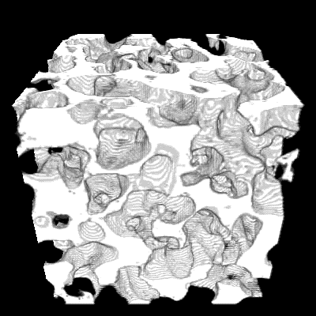
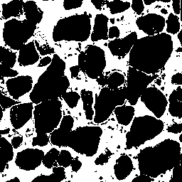
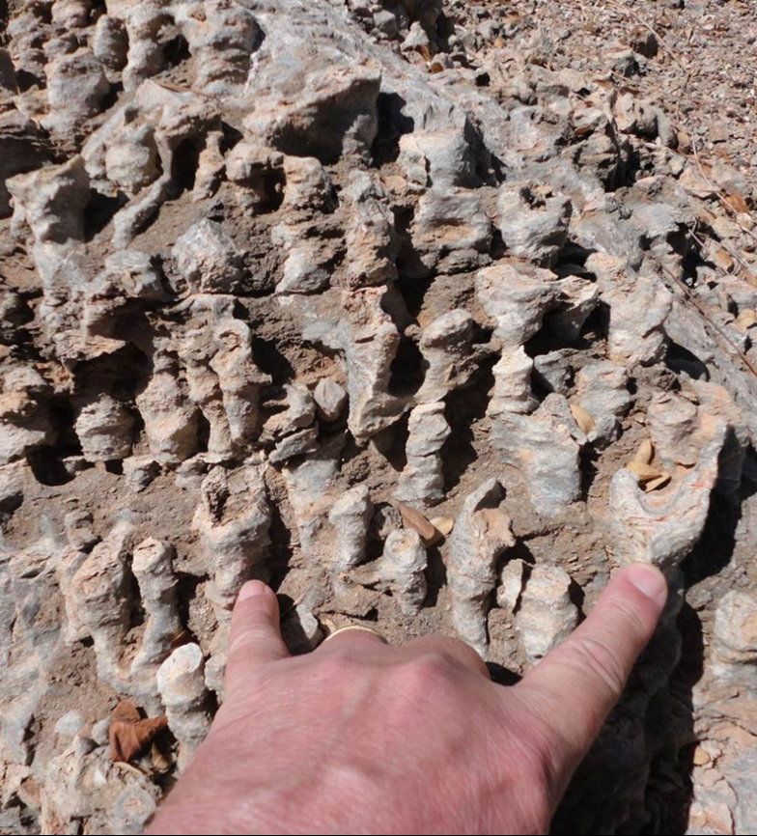
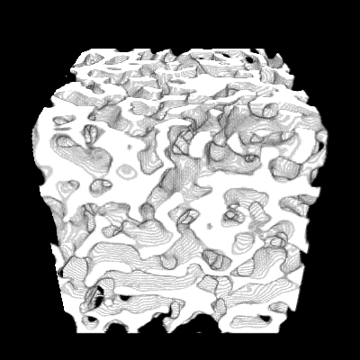
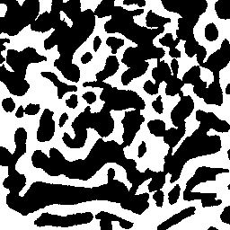
Uniform structures
Grains
‘Structure 2’
Notes:
Rounded grains
Long range connectivity
Emphasize that this training image should be horizontal, no vertical TIs avaiable, that is why the reconstructed model looks isotropic

Slide 4
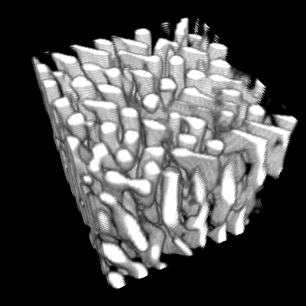


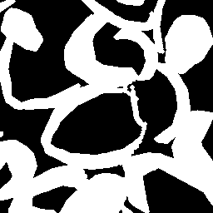
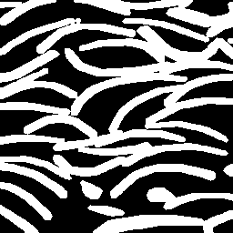
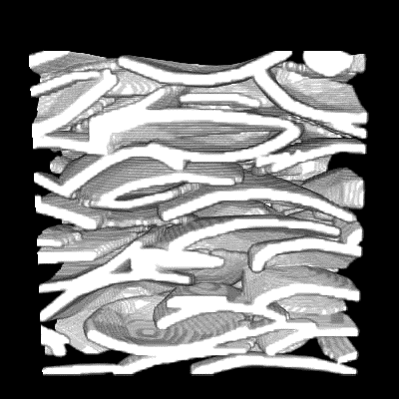
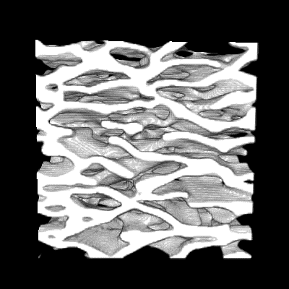
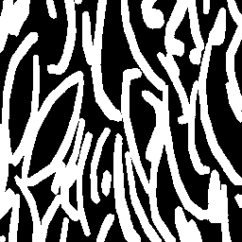
Anisotropic
‘Zebra’
Ola’s Coquina
Ola’s model
Our reconstruction
Notes:
if appropriate TIs are provided, a natural structure can be reconstructed
In return, it means that the selection of TIs will strongly influence the model quality.

Slide 5
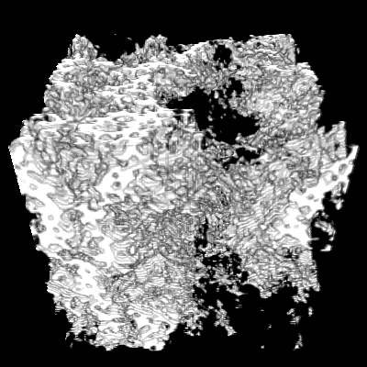
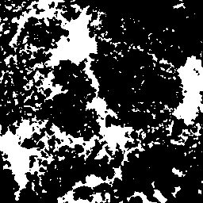
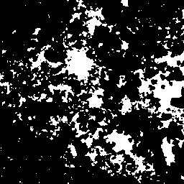

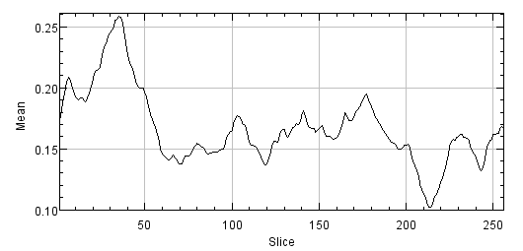
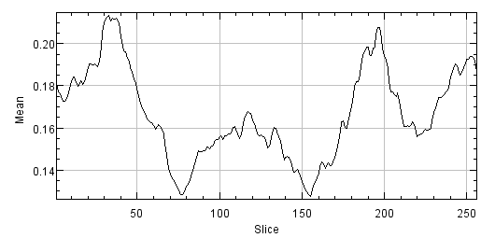
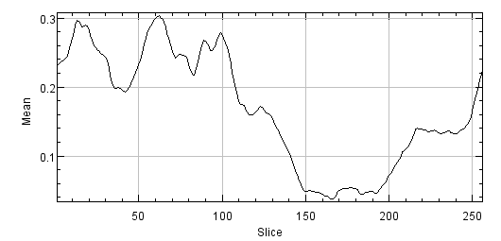
Non-stationary
‘Two-scale C’
Φ=27.0%
Φ=19.6%
Φ=4.9%
(Reconstruction) Porosity per slice in 3 directions

Slide 6
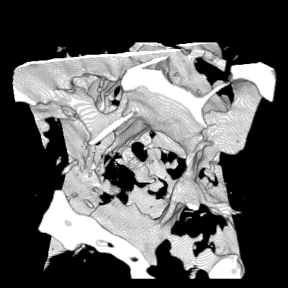
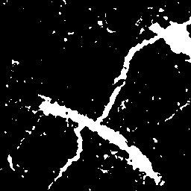
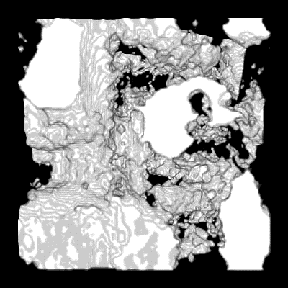
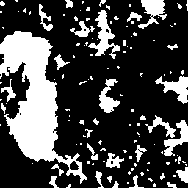
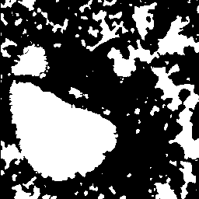
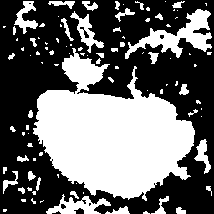
Irregular / extreme shape
Fractures
‘Two-scale B’
Notes:
Since we only use one TI for 3 directions, the model may not be very realistic to real fractures, but it is clear that the platy structure and the cross boundaries in TI are accurately reconstructed.
Both big and small pores are successfully generated even though not sufficient small pores are created. Noted that there are no such non-parametric methods that can deal with these type of model.

Slide 7
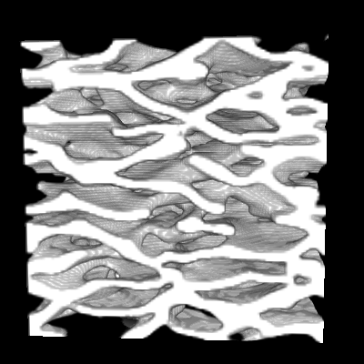
Validation – structural connectivity
Ola’s Coquina, Berea
X,Y direction
Z direction
Notes:
Larger pore size. Higher pore connectivity. But overall reasonably good

Slide 8
Validation – shape factor
Ola’s Coquina

Slide 9
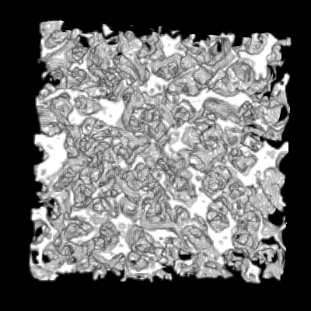
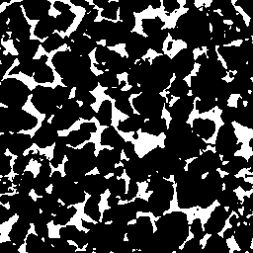
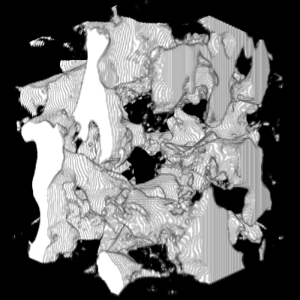
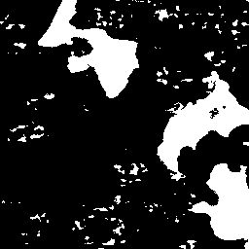
Validation – pore size distribution
Berea
‘Two-scale A’

Slide 10
Validation – porosity
Automatically matched global statistics (esp. porosity)
Porosity Model | TIs (%) | Original 3D (%) | Reconstruction (%) | Difference ratio (%) with TIs
Ola’s Coquina | 46.0 | 42.2 | 44.7, 44.9 | -2.9, -2.3
‘Structure 2’ | 44.8 |  | 42.4 | -5.2
Grains | 35.4 |  | 33.0, 37.2, 35.3 | -5.0, +6.7, +0.1
‘Two-scale B’ | 35.4 |  | 34.4 | -2.8
Berea | 20.7 | 19.6 | 20.6, 20.0 | -0.4, -3.1
‘Two-scale A’ | 19.8 | 20.5 | 20.3, 20.4 | +2.6, +2.8
‘Two-scale C’ | 17.2 |  | 16.7 | -2.6
Fractures | 10.9 |  | 9.9, 11.8 | -9.8, +8.2
Notes:
Due to limited time, we haven’t done too many tests. But based on all that we generate I think the porosity is matched perfectly well, usually with a difference ratio below 5%

Slide 11
Validation – flow properties
Network properties | Berea CT | Model
Number of pores: | 6248 | 6164
Number of throats: | 11017 | 10709
Avg. coordination number: | 3.46143 | 3.41775
Net porosity: | 0.19488 | 0.206434
Absolute permeability (mD) | 1594.08 | 2574.78

Slide 12
Methodology overview
Initial model
EM based optimization engine
Distance Map
Histogram control
Bimodal transformation
e.g. PAR
Enable us to distinguish non-stationarity, inner area of large pore/solid
Preserve both local similarity & global statistics

Slide 13
EM based texture synthesis
Expectation Maximization (Arthur et al. 1977)
Estimate parameter and hidden variables iteratively
Extension to texture synthesis:
2D to 2D (Kwatra et al. 2005)
2D to 3D (Kopf et al. 2007)
Notes:
an expectation–maximization (EM) algorithm is an iterative method to find maximum likelihood estimates of parameters in models, where the model depends on hidden variables.

Slide 14
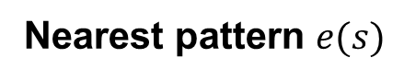
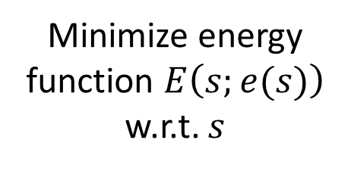
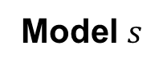
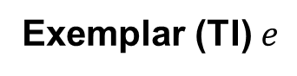
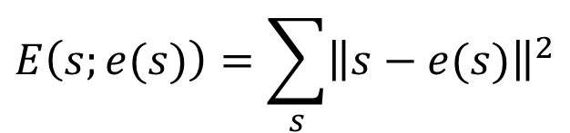
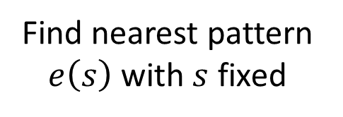
EM based texture synthesis
Exemplar (TI) $e$
Nearest pattern $e(s)$
Model $s$
$$E\left(s;e(s)\right)=\sum_{s}{{\left\|s−e(s)\right\|}^{2}}$$
E-step Optimize
M-step
Search
Minimize energy function $E\left(s;e(s)\right)$ w.r.t. $s$
Find nearest pattern $e\left(s\right)$ with $s$ fixed
Notes:
an expectation–maximization (EM) algorithm is an iterative method to find maximum likelihood estimates of parameters in models, where the model depends on hidden variables.

Slide 15
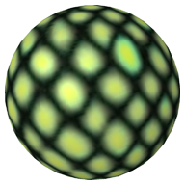
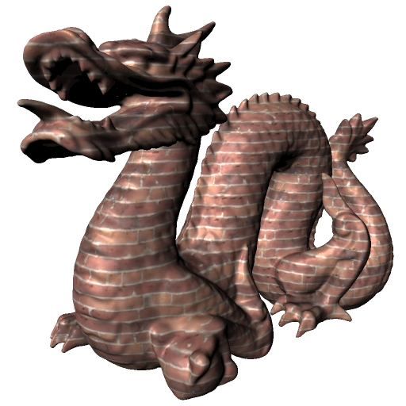
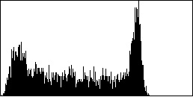
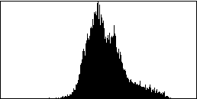
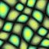

EM based texture synthesis
Limitations:
Simple: need to be very repetitive
Uniform: balanced volume fraction
Unable for non-stationary, complex shape
In terms of porous media reconstruction…
Kopf et al. SIGGRAPH 2007

Slide 16
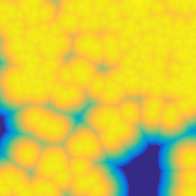
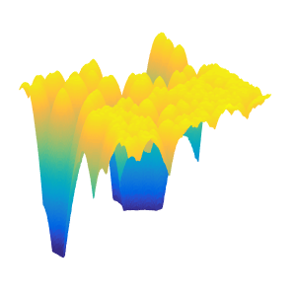
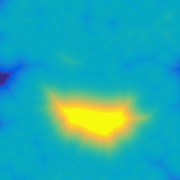
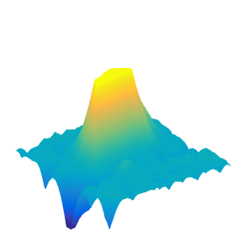
Methodology overview
Initial model
EM based optimization engine
Distance Map
Histogram control
Bimodal transformation
e.g. PAR
Avoid wrong local minimum → distinguish inner area of large pore / solid

Slide 17
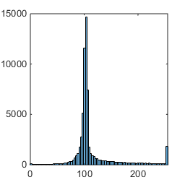
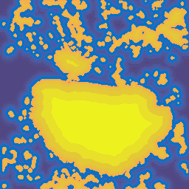
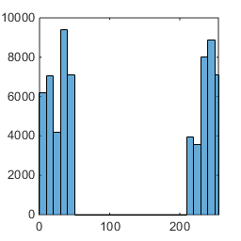
Methodology overview
Initial model
EM based optimization engine
Distance Map
Histogram control
Bimodal transformation
e.g. PAR
Enhance low-frequency element by ‘clustering’ a range of distance bins.
Notes:
Skip this slide. Too technical

Slide 18
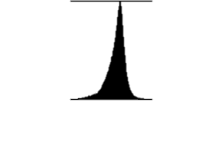
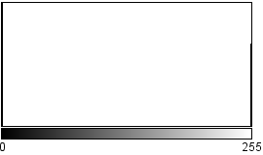
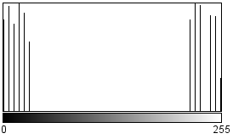
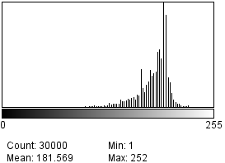


Methodology overview
Initial model
EM based optimization engine
Distance Map
Histogram control
Bimodal transformation
e.g. PAR
Avoid aggregation in single peak model
Equalized Bimodal
distribution
Balanced model:
60% & 40%
Min: 1
Max: 252
Min: 97
Max: 206
OK…
Better!
Aggregation causes information lost
Notes:
Skip this slide. Too technical

Slide 19

Methodology overview
Initial model
EM based optimization engine
Distance Map
Histogram control
Bimodal transformation
e.g. PAR
Methodology overview
Index histogram (Search step): uniform selection of nearest pattern from TI
Colour histogram (Optimize step): preserve global statistics (porosity & PSD)
Down weight the outlier
Expected distribution

Slide 20
Future work
Two-scale features especially smaller scale
A case study: influence of cross-scale connection
Multiple TIs / oblique sections for better quality
Layered structure
Real data analysis

Slide 21



Case study: cross-scale connection
‘Two-scale A’
Macro pores
φ: 0.168
K (mD): 15.63
Cross-scale connection?
with cross-scale connection
φ : 0.203
K (mD): 71.59
Micro pores
φ : 0.036
K (mD): 0.0188
without cross-scale connection
φ : 0.202
K (mD): 18.26

Slide 22
Case study: cross-scale connection
‘Two-scale A’
without
K = 18.26 mD
+
with
K = 71.59 mD
Notes:
With cross-scale connection, Kro will keep at high level until a much higher water saturation is reached as oil replaces water gradually

Slide 23
Conclusion
A new method based on optimization framework, for the challenging task of reconstructing complex 3D porous structure using 2D images:
Complex irregular shapes
Anisotropic
Non-stationary, extremely heterogeneous
The wide applicability and quality outperforms previous non-parametric methods
Multi-scale structure will be further improved

Slide 24
Thank you!
Contact:
Zeyun Jiang zeyun.jiang@hw.ac.uk
Tianshen Huang th2@hw.ac.uk
Notes:
LIST PROJECT NAME (EG REACTCARB) AND THE LONGER DESCRIPTION OF THE PROJECT (EG PORE-SCALE REACTIVE TRANSPORT MODELLING) LIST ALL PROJECT PEOPLE BUT UNDERLINE AND BOLD FACE THE KEY PERSON WHO IS DOING THE WORK AND SHOULD BE CONTACTED FIRST (EG ZEYUN)
REMEMBER TO EDIT THE FOOTER OF THE PRESENTATION TO LIST YOUR PROJECT NAME

Slide 25






Multi-resolution
TI
Level 0
Level 1
Level 2
Model

Slide 26




EM based texture synthesis
Multi-resolution energy minimization process
Notes:
an expectation–maximization (EM) algorithm is an iterative method to find maximum likelihood estimates of parameters in models, where the model depends on hidden variables.

Slide 27


Bimodal transform
Initial model
EM based optimization engine
Distance Map
Histogram control
Bimodal transformation
e.g. PAR
Histogram equalization: enhance low-frequency element
https://en.wikipedia.org/wiki/Histogram_equalization
https://www.math.uci.edu/icamp/courses/math77c/demos/hist_eq.pdf

Slide 28



Methodology overview
Initial model
EM based optimization engine
Distance Map
Histogram control
Bimodal transformation
e.g. PAR
Methodology overview
Index histogram (Search step): uniform selection of nearest pattern from TI
Reconstruction
Index histogram:
Usage of patterns from TI
Training image

Slide 29


Future work
Two-scale features especially smaller scale
Multiple TIs / oblique sections for better quality
Layered structure
Layered Solid Texture Synthesis from a Single 2D Exemplar. Takayama and Igarashi. 2009

Slide 30
Impact and integration
Objectives:
Integrate macro-scale model with micro-structure reconstruction honouring realistic cross-scale connection for specific carbonates.
Reconstruct multi-component (oil, water, solid etc.) pore structure based on multi-phase image segmentation.
Provide software tools to measure geometry and topology of experimental samples and carry out pore network simulations, and upscaling multi-phase flow functions with experimental results
ROCKTYPE 2
SATUTRACK 2
GeoMeChem
Main business impact:
Accurate characterization of multi-scale porous media at pore scale
Provide a workflow to complement SCAL for reservoir characterization with proposed upscaling methods.
Technology transfer:
Provide software PAR for investigating complicated microstructure for carbonate rocks in terms of morphological features that directly relates to petro-physics.

Slide 31
PROMEF Team
LEAD PROFESSOR Zeyun Jiang
OTHER PROFESSORS Rink van Dijke
Sebastian Geiger
Rachel Wood
RESEARCHERS Tianshen Huang
Dmytro Petrovskyy
BG FOCAL POINTS PETROBRAS FOCAL POINTS
Rodrigo Surmas
Maury Duarte

Slide 32
PROMEF: Key Facts
Objectives
Accurate pore space reconstruction of multiscale and varying shape structure in Carbonates.
Efficient prediction of multi-phase flow functions at core to log scales
Key deliverables
New workflow incorporating spatial wettability into 3D heterogeneous structures. (Year 2) Task 2, 3
New method for explicit integration of various scale pore space systems. (Year 2) Task 2
Multiphase flow simulations from micro- to meso-scale in heterogeneous carbonates with spatially varying wettability. (Year 3) task 4
Rigorous physically informed flow functions at the meter scale that include structural and wettability heterogeneities at the underlying length-scales. (Year 3) task 5, 6, 7
Business impact
Efficient prediction of multi-phase flow functions based on multi-scale pore space images
Rapid interpretation of log data
Technology transfer
Digital core analysis workflow and software for pore-scale multi-phase flow simulation
Links to Brazil
UFSC, UFPR, Rio Claro (core data, microCT images, pore networks) – SWB visits planned
Publications and presentations
Forthcoming

Slide 33
ICCR Phase II project landscape
Data
VSP
Stevensite
SATUTRACK 2
4D
ROCKTYPE 2
GeoMeChem
MECHSEIS 2
PROMEF
Models
ReactCarb
Workflows developed and tested on shared datasets
Pore-scale
Reservoir-scale
Notes:
THIS SLIDE IS NOW AT THE END OF THE PRESENTATION TO PROVIDE KEY INFORMATION TO THE SPONSORS

Slide 34
PROMEF: Links to other projects
RockType II
Interact on reconstruction of realistic pore structures related to diagenetic events
Provide software tools for multi-phase flow predictions from multi-scale pore space images
SatuTrack II
Obtain pore-scale wettability distributions from experimental data on analogue materials, as well as (trapped) saturation data from micro-CT
Provide software tools for multi-phase flow predictions from multi-scale pore space images
ReactCarb
Obtain semi-quantitative rules that guide distribution of wettability alteration during oil charge
Provide pore-network software tools for multi-phase flow predictions of kr and Pc under different wettability conditions

Slide 35
PROMEF: Deliverables timetable
2015 2016 2017 2018
 | Q1 | Q2 | Q3 | Q4 | Q1 | Q2 | Q3 | Q4 | Q1 | Q2 | Q3 | Q4 | Q1 | Q2
1
2
3
4
5
6
7
8
Key tasks / deliverables
Hiring and training of PhD students, literature review of pore-scale reconstruction, network extraction and multi-phase flow
Pore-space reconstruction 1 – accurately honour pore geometry and topology form 2D to 3D models
Pore-space reconstruction 2 – explicitly integrate multi-scale pore space systems
Parallelise multi-scale network generation – improve cross-scale connectivity (including coarse-links) and spatial correlation
Improve skeleton-based simulation of drainage and imbibition and incorporate spatial wettability into 3D heterogeneous structures
Simulate multi-phase hydraulic and electrical properties from micro- to meso-scale with virtual integrated network
Derive rigorous physically informed flow functions at core- and log-scale
Identify length-scales of representative measurements based on available data

